Slide 1
Air Traffic Passenger Statistics
T5
By :Ajwad Almajnuni

Slide 2
Data description
This dataset about San Francisco International Airport Report on Monthly Passenger Traffic Statistics . San Francisco International Airport (SFO) is an international airport in San Mateo County. It has flights to points throughout North America and is a major gateway to Europe and Asia.
San Francisco International Airport is the largest airport in the San Francisco Bay Area and the second busiest airport in California after Los Angeles Airport. In 2017, it was the seventh busiest airport in the United States and 24th busiest airport in the world by passenger numbers. The data contains 46670 rows and 12 columns .

Slide 3
Goals
The goal of analyzing Air Traffic Passenger Statistics data is because there is a company that wants to present an advertising campaign for a specific product inside the airport, so the data will be analyzed according to the number of passengers to attract the largest possible number for this product.

Slide 4
The tools used for this project
Python and Jupyter Notebook
Pandas
Matplotlib and Seaborn
To write the code
for data manipulation
for plotting visuialization

Slide 5
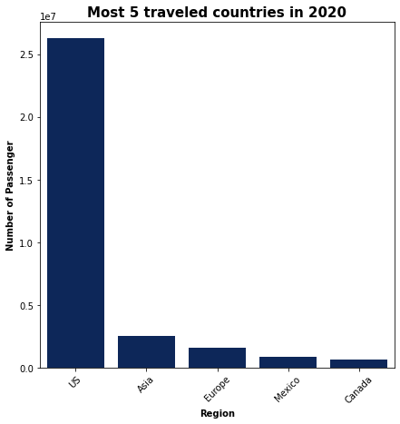
The five most visited countries in 2020

Slide 6
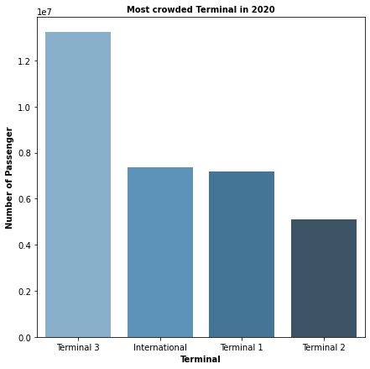
Most crowded Terminal in 2020

Slide 7
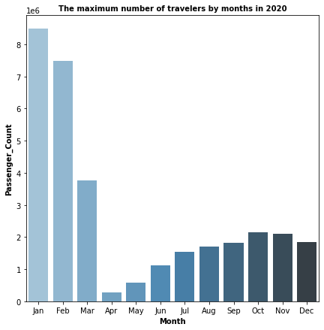
The maximum number of travelers by months in 2020

Slide 8
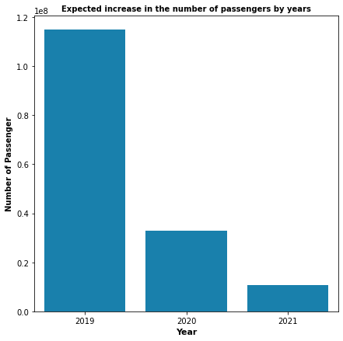
ِِExpected increase in the number of passengers by years

Slide 9
Conclusion
1- Through the first chart, it was found that the most traveled country is the United States of America, so we see that he does not need to translate the advertisement into other languages.
2- The advertisement is supposed to be published in the first months of the year because it was shown through the graph that the largest number of passengers travel in the months
1 and 2.
3- Through the third graph, it was found that there is a significant shortage of travelers during the years 2020 and 2021. It is possible that the covid-19 virus caused this shortage, but it is expected that there will be an increase in the number of travelers. Therefore, it would be better to postpone the announcement until next year.

Slide 10
Thank you

